Slide 1

Presentation for the Front-end Part
3 mins per group

Slide 2
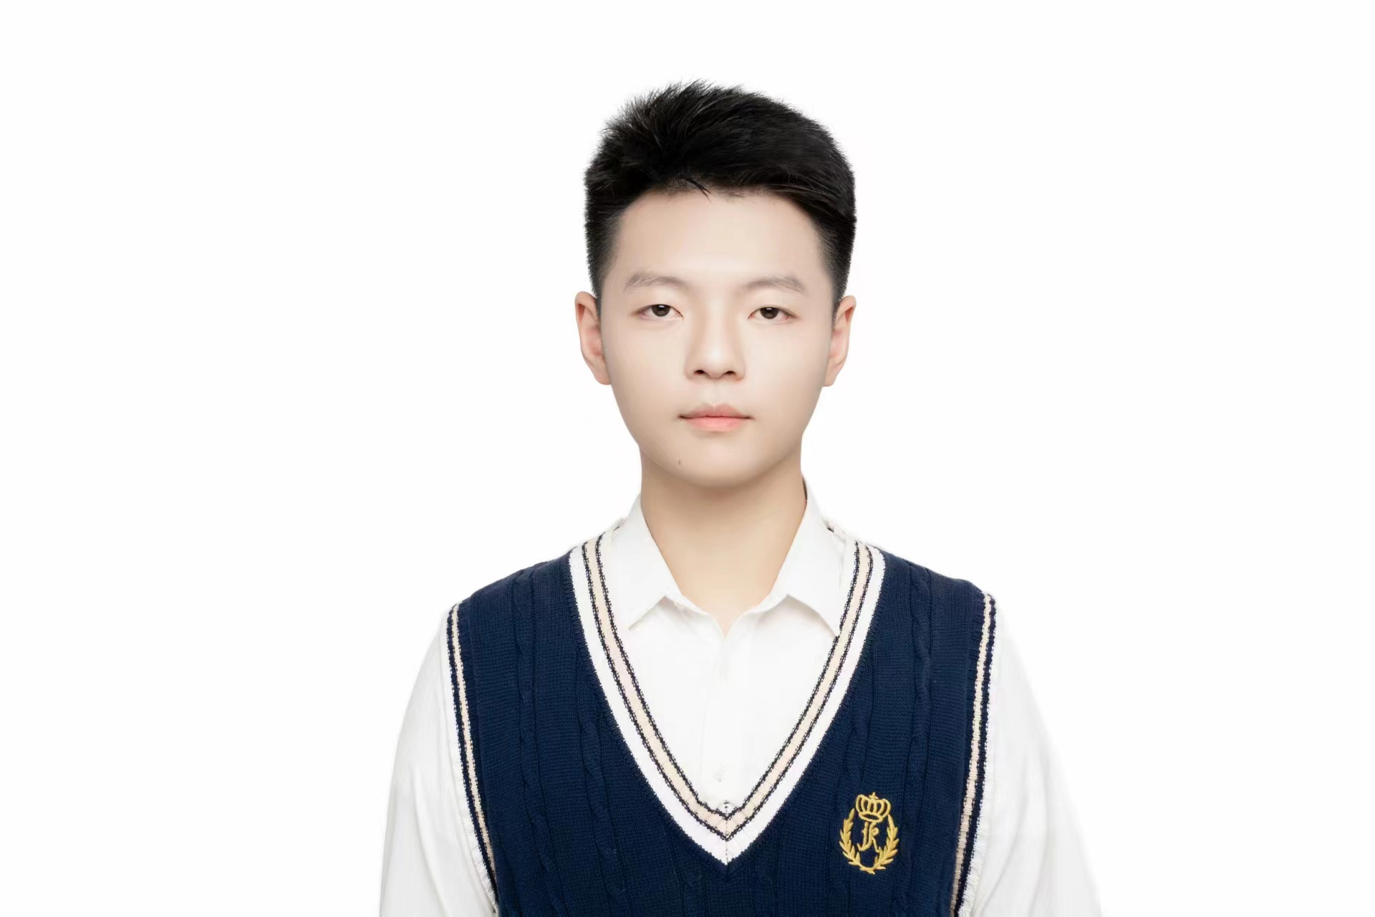

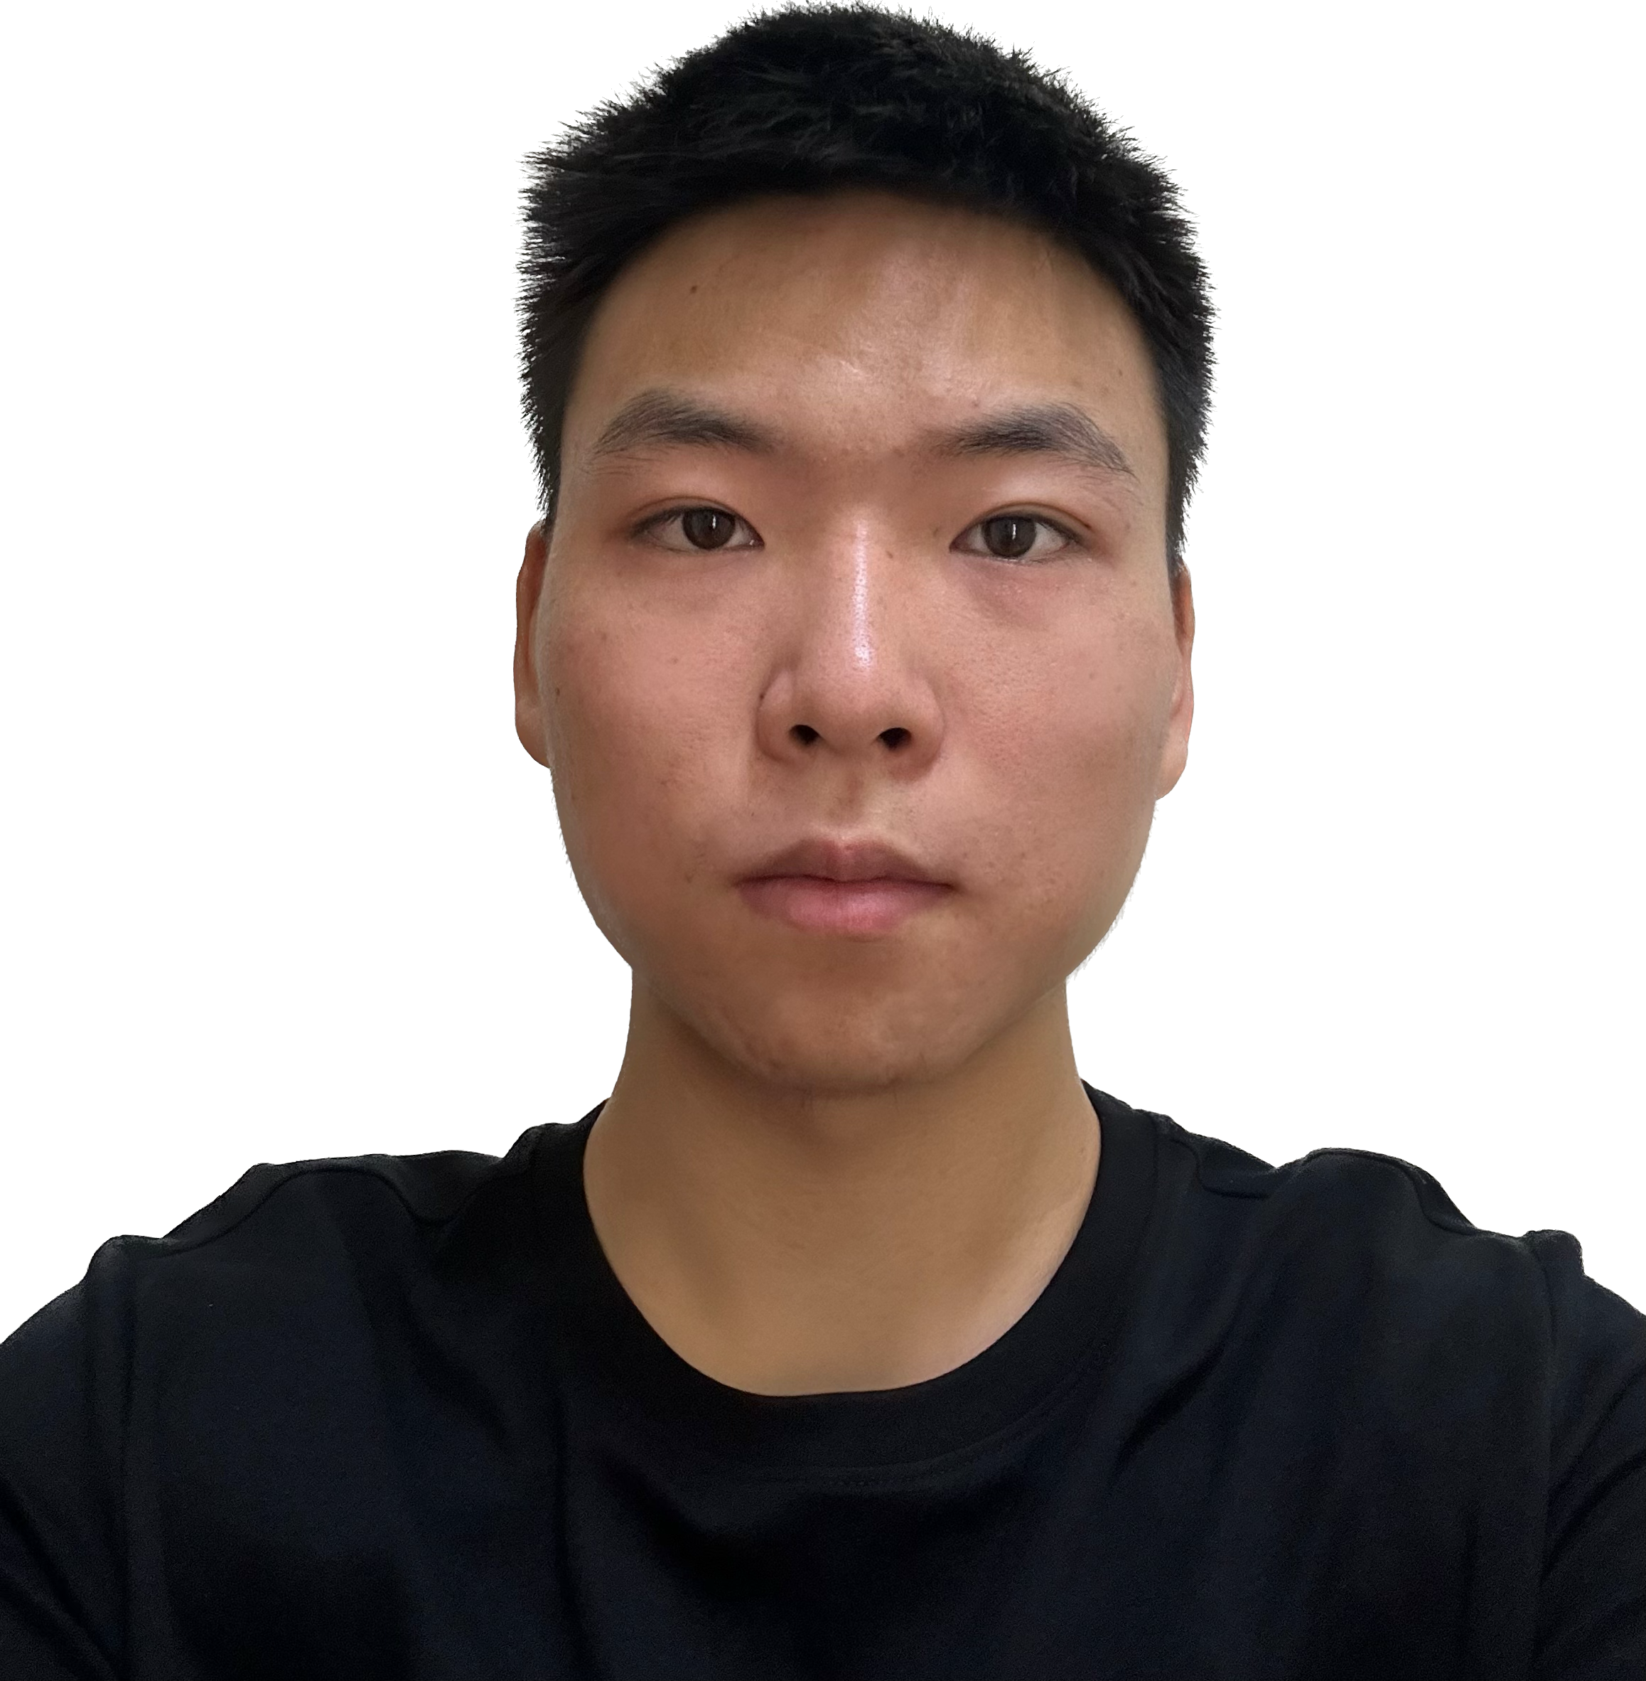
1. Member
1. shenxinyan 20232090 232.
2. wurunxin 20232083 232.
3. zhaomeiling 20232089 232.
zhaomeiling
wurunxin
shenxinyan
** project leader

Slide 3
2.
Paparazzi news
Project name:Paparazzi news,A social platform designed to help users identify and classify fake news through collective intelligence and transparent voting.
Project goal:
Provide a community-driven verification system | Users collaborate to evaluate news authenticity
Increase digital media literacy | Encourage evidence-based thinking
Reduce the spread of misinformation | Classify content into True / Fake / Neutral
Enable transparency in public opinions | Display voting results and comments openly
Simple and accessible design | Browser-based, no backend required for prototype

Slide 4
3. Features
F1 Check the news
F2 The authenticity of the voting news
F3 Comment on the news

Slide 5
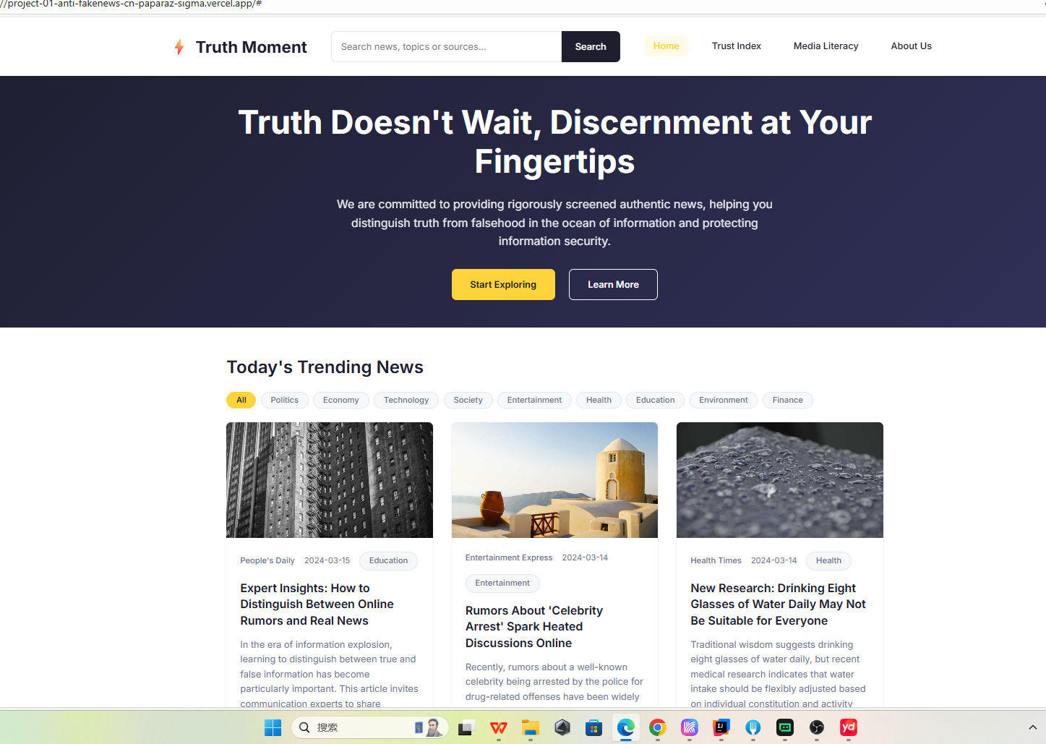
5. Home page
- list of news, filter (all / fake / not fake), pagination, and how many items per page?

Slide 6
4. Tech Stack
Frontend：
React
JavaScript/ES6+
CSS3 with modern features
Vite (build tool)
Backend：
Node.js
Express.js
MongoDB (database)

Slide 7
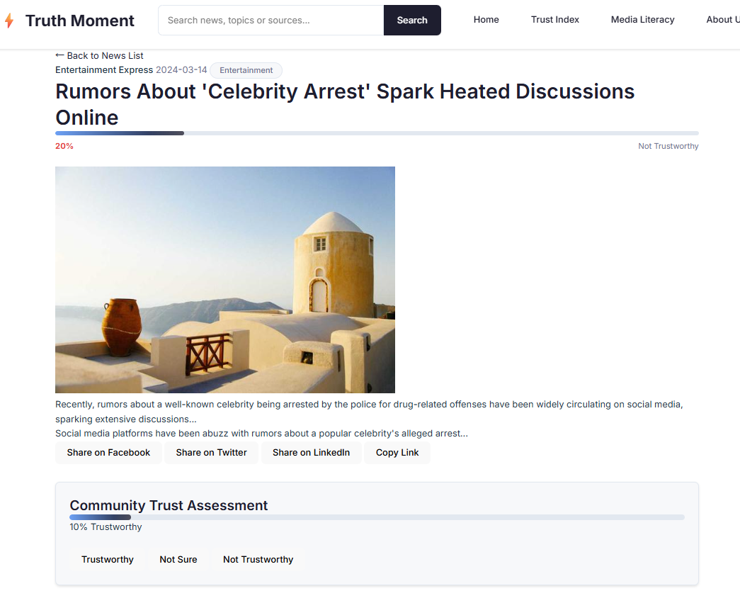
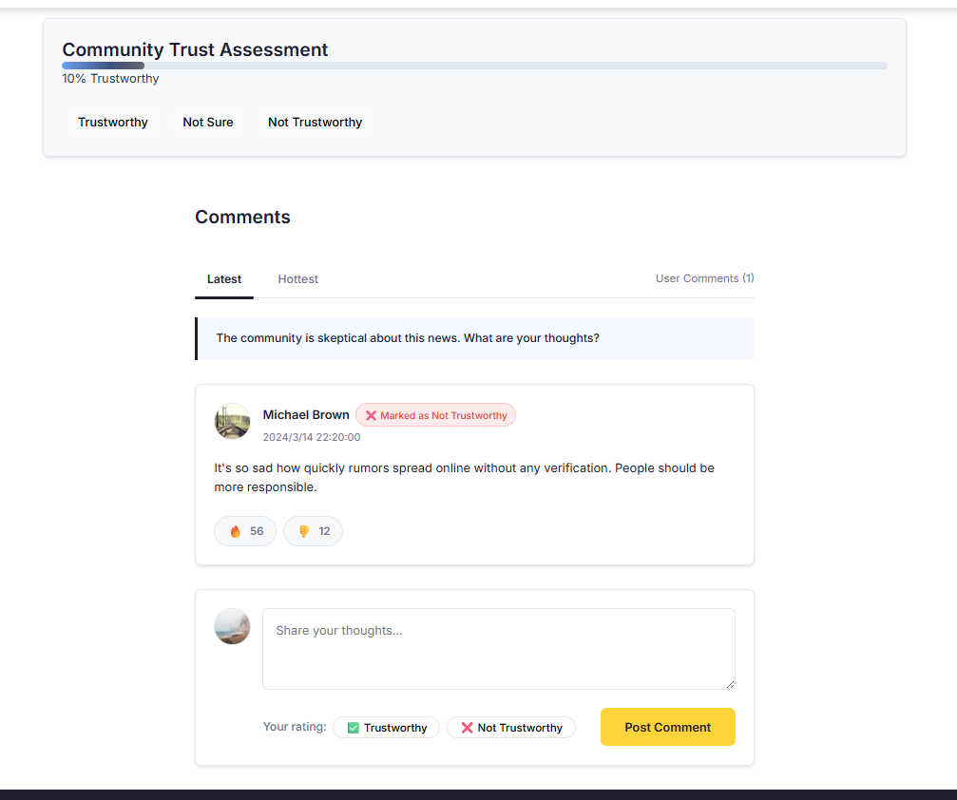
6. News Details Page
- Click on one news item to show: topic, full details, reporter, date/time, image (URL) - Show comment section and voting results (fake / not fake)

Slide 8

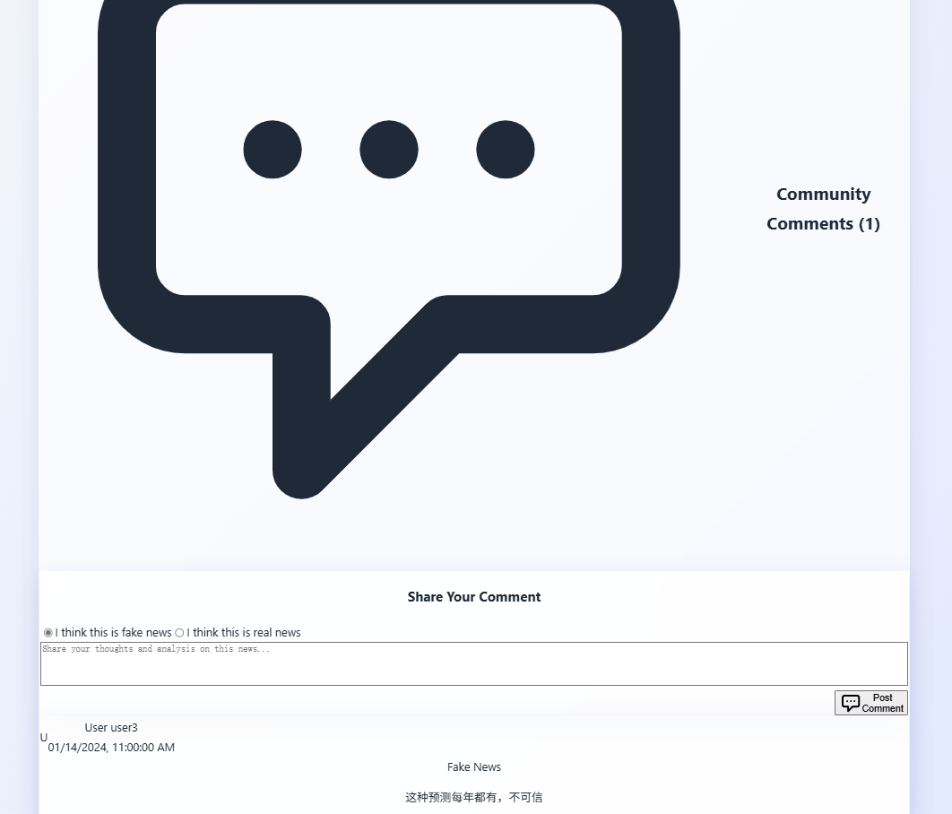
7. Vote & Comment Feature
- Demonstrate voting and adding a comment or image link - Show that new data appears in the comment list immediately

Slide 9
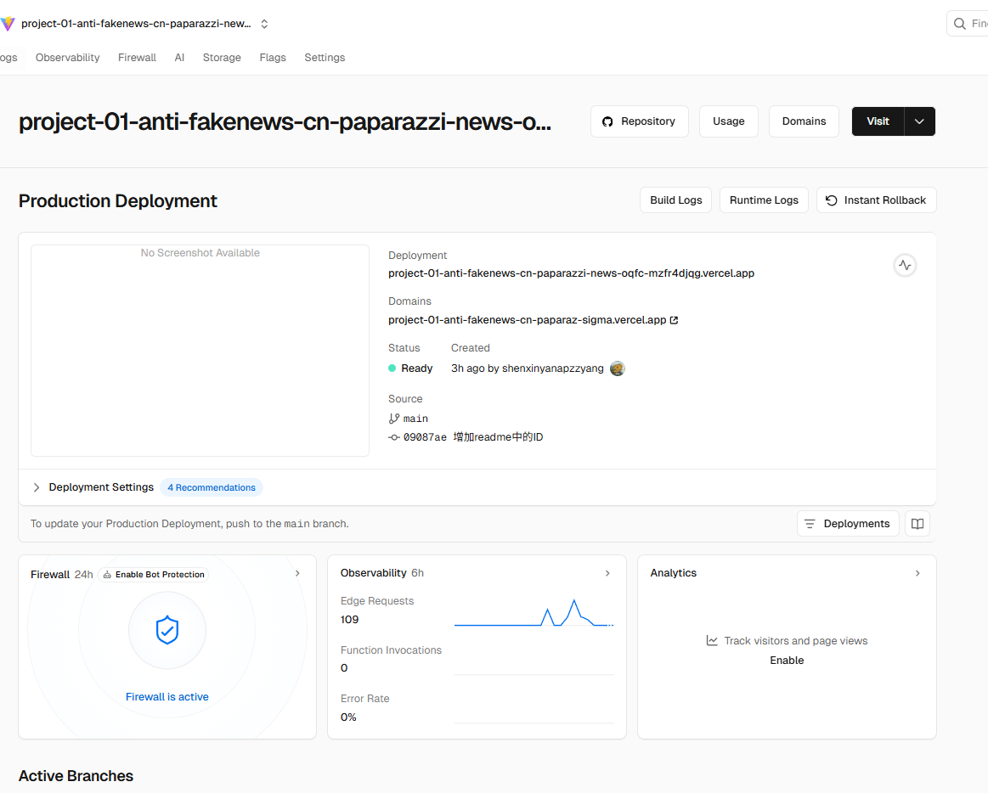
8. Deployment with Versel
- Mention mock data used for testing and pagination implemented
URL:https://project-01-anti-fakenews-cn-paparazzi-news-5hz3penn5.vercel.app/

Slide 10
Submission
Record 3-5 mins presentation and submit to Moodle (Only one people in the team will submit in Moodle, you can submit to any section)
Submission Deadline : 9th November 11.59 pm

Slide 11
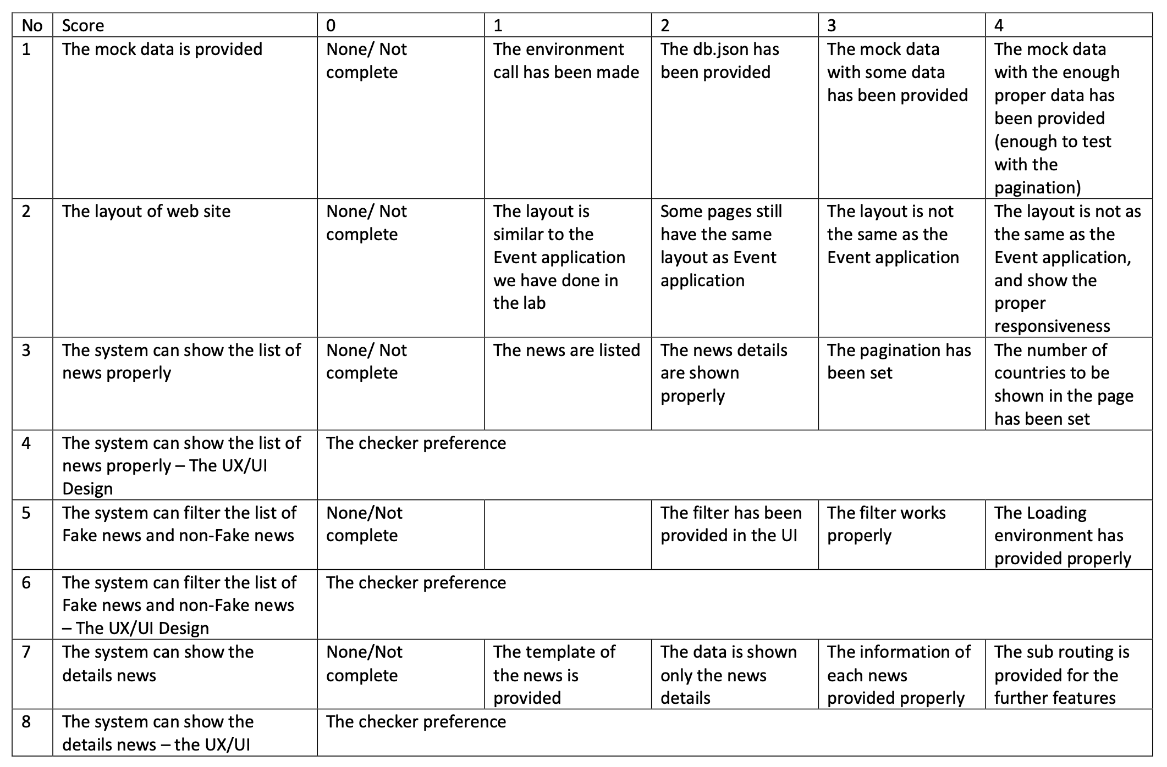

Slide 12
